Slide 1
Ms. Mary Philip
Department of Political Science
INDIAN PARTY SYSTEM

Slide 2
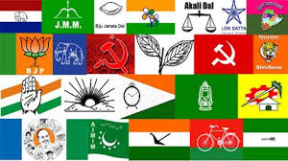
INDIAN PARTY SYSTEM

Slide 3
ORIGIN OF PARTIES
Based on Human nature
Based on Economic interests
Based on Religion and Community

Slide 4
TYPES OF POLITICAL PARTIES
ONE PARTY SYSTEM
Ideological one party system- Fascist,Nazi , Communist
Authoritarian one party system-Myanmar,Iran,Syria
Dominant one party system-India in the past and now
TWO PARTY SYSTEM
As in U.S.A,U.K,Australia
MULTI PARTY SYSTEM
As in India,France,Germany

Slide 5
OTHER TYPES
Charismatic leader-oriented party:Sukarno in Indonesia
Ideological persuasion oriented : Leftist,Rightist and Centrist
Geographically formed : National,state and Regional

Slide 6
MAURICE DUVERGER’S CLASSIFICATION
CAUCUS TYPE – U.S. political parties
BRANCH TYPE – INC, BJP
CELL TYPE – Communist parties in capitalist countries
MILITIA TYPE – Nazi party under Hitler

Slide 7
Features of Political Parties in INDIA
Multi Party system
One part dominant system
Lack of clear ideology
Personality cult
Based on Traditional factors
Emergence of religious parties
Factions and Defections
Lack of effective opposition

